Slide 1

Limit Reference Points and the Fish Stocks Provisions
Joint TESA/NOG Workshop
Break-out Group Exercise 4
December 3 2021

Slide 2

Exercise 4

Slide 3
Exercise 4
Exercise Goal:
Identify ways to define a single metric of stock status for Arctic Sardine MU1 in a data-rich context when there is more than one model that is an acceptable characterization of the population dynamics.

Slide 4
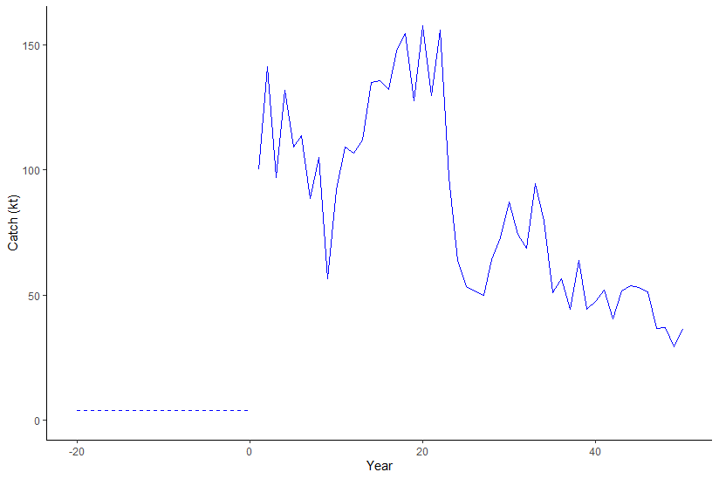
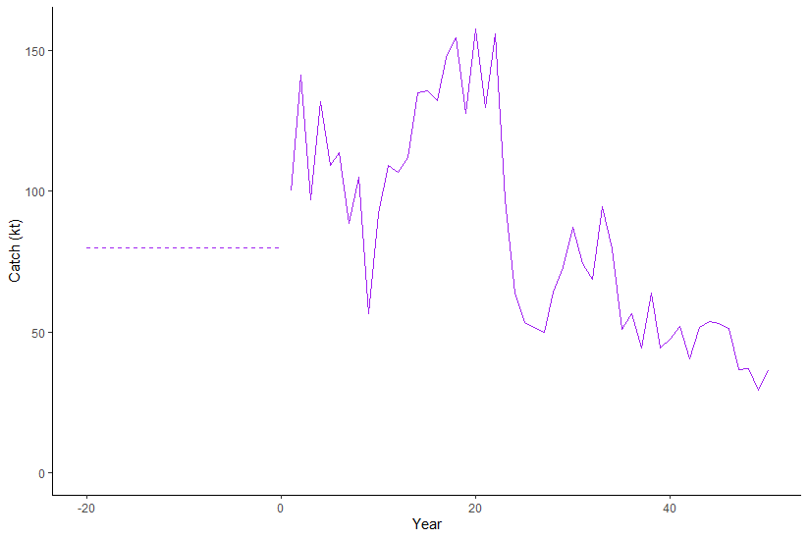
2 Models with Different Assumptions for Historical Catch
Assume that prior to year 1 of the time series, there were international fleets fishing Arctic Sardine and the magnitude of those historical catches is unknown.

Slide 5
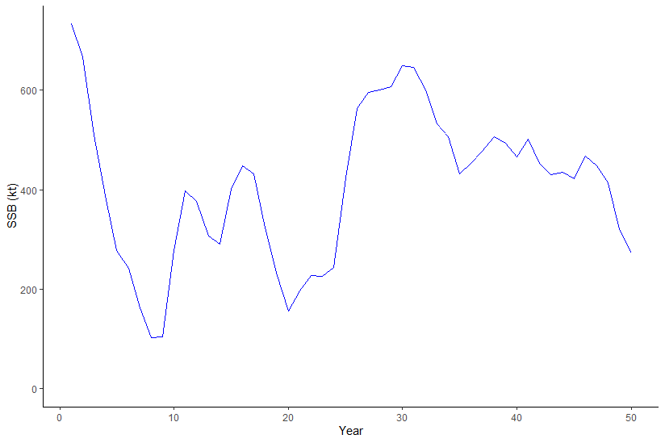
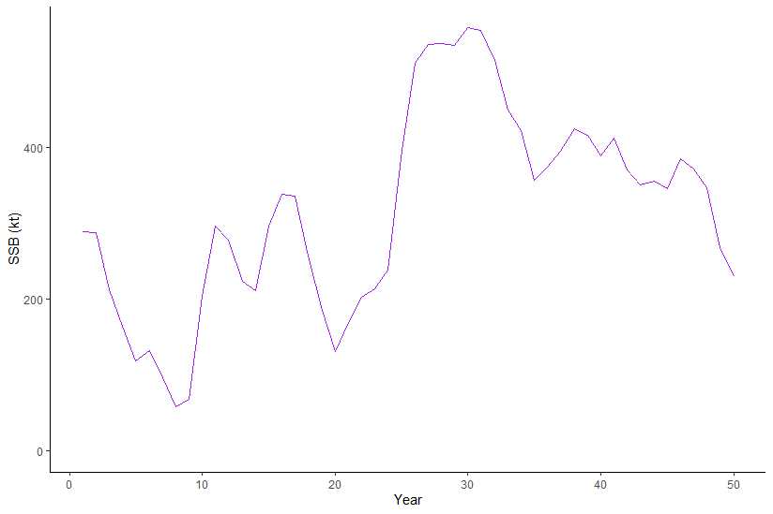
Exercise 4
Assumption influences the initial depletion

Slide 6
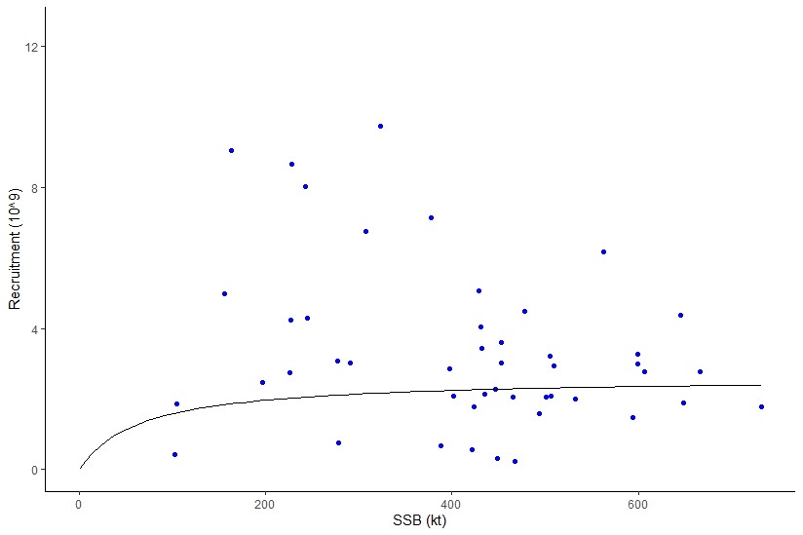
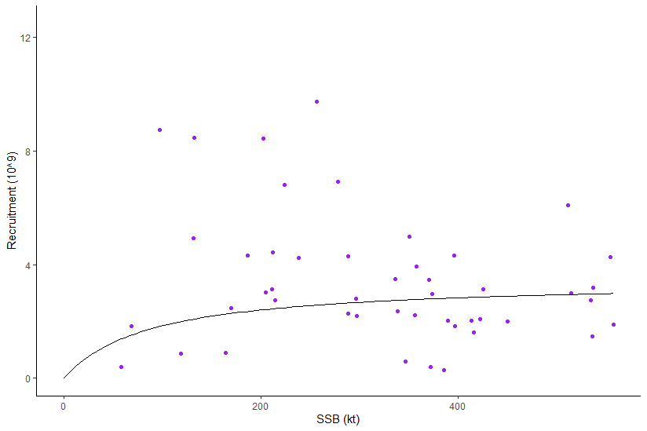
Exercise 4
Assumption influences the initial depletion
R₀, SRR, and therefore B₀ and B_{MSY} reference points

Slide 7
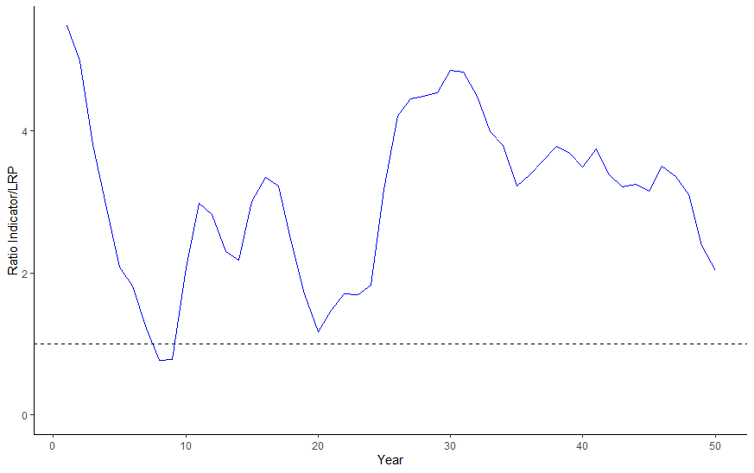
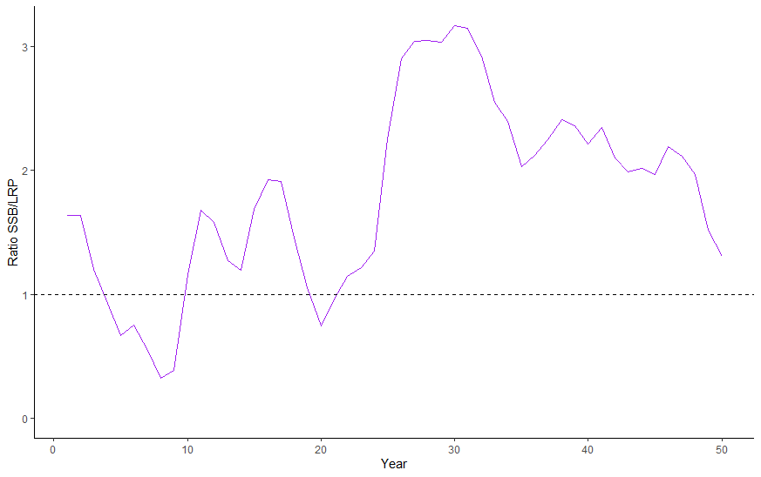
Exercise 4
Evaluate at least 2 approaches to defining a metric of stock status for Arctic Sardine MU1 and identify the preferred approach.
Use an LRP of 0.2SSB₀

Slide 8
Exercise 4
Some options:
Indicator based on one model
Indicator based on multiple models (mean, weighted mean base on plausibility)
Empirical indicator (e.g., acoustic index of SSB, relative exploitation rate)

Slide 9
BO Group Summary
One model vs. model ensemble
Simple exercise – equal weight on each model
Characterize the uncertainty
SSB/LRP for individual models
Between models
Decision really depends on plausibility and how different the status between the two models is

Slide 10
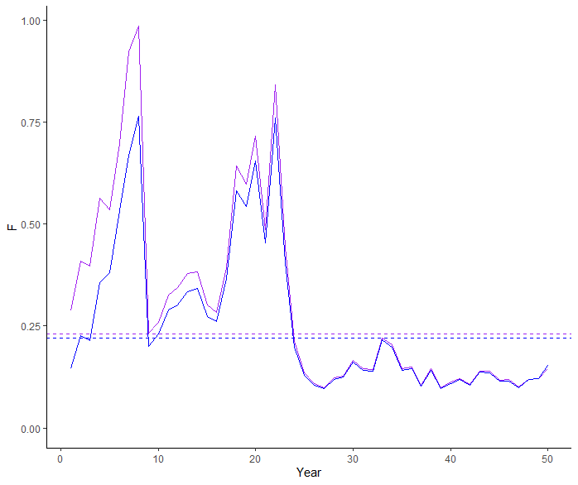
BO Group Summary
F is almost identical between the 2 models at the end of the time series (focus management on F)

Slide 11
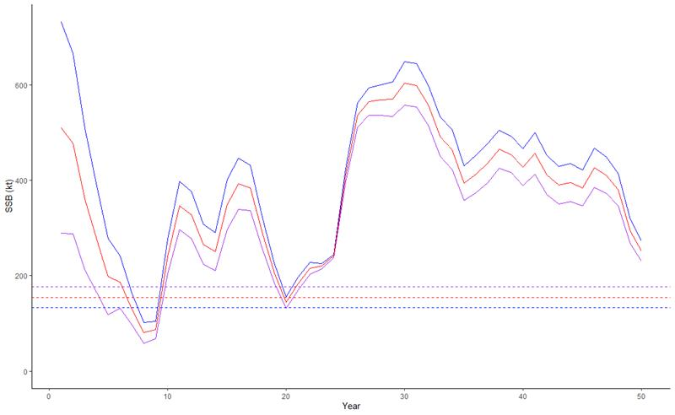
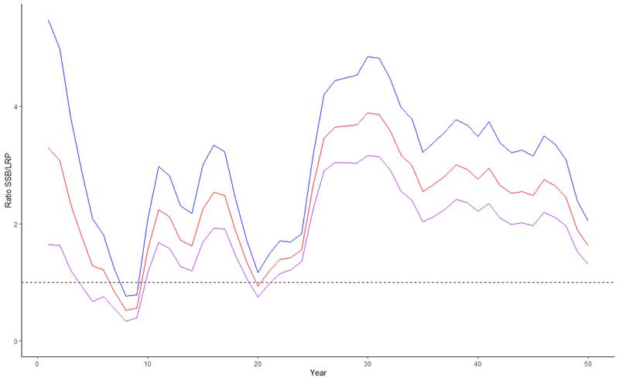
BO Group Summary
If one scenario is much more likely?
yes -> pick a model
no -> is the status the same for both models?
yes -> pick a model?
no -> average
(weighted average or not, based on expert judgement or model fit)
Consider behavior of LRP with model

Slide 12
BO Group Summary
Objective here was to discuss some of the considerations and not to focus too much selecting the “best” option for this specific example

